Slide 1
Chapter 5
Security Threats to
Electronic Commerce
Electronic Commerce

Slide 2
Objectives
Important computer and electronic commerce security terms
Why secrecy, integrity, and necessity are three parts of any security program
The roles of copyright and intellectual property and their importance in any study of electronic commerce

Slide 3
Objectives
Threats and counter measures to eliminate or reduce threats
Specific threats to client machines, Web servers, and commerce servers
Enhance security in back office products, such as database servers
How security protocols plug security holes
Roles encryption and certificates play

Slide 4
Security Overview
Many fears to overcome
  Intercepted e-mail messages
  Unauthorized access to digital intelligence
  Credit card information falling into the wrong hands
Two types of computer security
  Physical - protection of tangible objects
  Logical - protection of non-physical objects

Slide 5
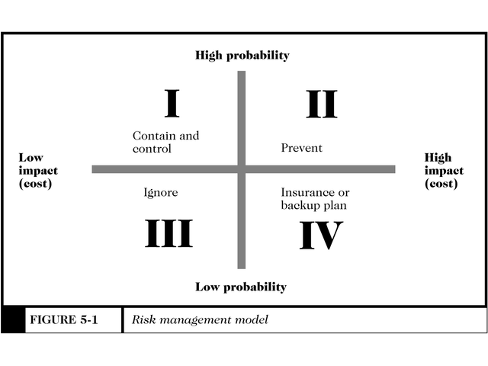
Security Overview
Figure 5-1
Countermeasures are procedures, either physical or logical, that recognize, reduce, or eliminate a threat

Slide 6
Computer Security Classification
Secrecy
  Protecting against unauthorized data disclosure and ensuring the authenticity of the data’s source
Integrity
  Preventing unauthorized data modification
Necessity
  Preventing data delays or denials (removal)

Slide 7
Copyright and
Intellectual Property
Copyright
  Protecting expression
    Literary and musical works
    Pictorial, graphic, and sculptural works
    Motion pictures and other audiovisual works
    Sound recordings
    Architectural works

Slide 8
Copyright and
Intellectual Property
Intellectual property
  The ownership of ideas and control over the tangible or virtual representation of those ideas
U.S. Copyright Act of 1976
  Protects previously stated items for a fixed period of time
  Copyright Clearance Center
    Clearinghouse for U.S. copyright information

Slide 9
Security Policy and
Integrated Security
Security policy is a written statement describing what assets are to be protected and why, who is responsible, which behaviors are acceptable or not
  Physical security
  Network security
  Access authorizations
  Virus protection
  Disaster recovery

Slide 10
Specific Elements of a Security Policy
Authentication
  Who is trying to access the site?
Access Control
  Who is allowed to logon and access the site?
Secrecy
  Who is permitted to view selected information

Slide 11
Specific Elements of a Security Policy
Data integrity
  Who is allowed to change data?
Audit
  What and who causes selected events to occur, and when?

Slide 12
Intellectual Property Threats
The Internet presents a tempting target for intellectual property threats
  Very easy to reproduce an exact copy of anything found on the Internet
  People are unaware of copyright restrictions, and unwittingly infringe on them
    Fair use allows limited use of copyright material when certain conditions are met

Slide 13
Intellectual Property Threats
Cybersquatting
  The practice of registering a domain name that is the trademark of another person or company
    Cybersquatters hope that the owner of the trademark will pay huge shillings amounts to acquire the URL
    Some Cybersquatters misrepresent themselves as the trademark owner for fraudulent purposes

Slide 14
Electronic Commerce Threats
Client Threats
  Active Content
    Java applets, Active X controls, JavaScript, and VBScript
    Programs that interpret or execute instructions embedded in downloaded objects
    Malicious active content can be embedded into seemingly innocuous Web pages
    Cookies remember user names, passwords, and other commonly referenced information

Slide 15
Java, Java Applets, and JavaScript
Java is a high-level programming language developed by Sun Microsystems
Java code embedded into appliances can make them run more intelligently
Largest use of Java is in Web pages (free applets can be downloaded)
Platform independent - will run on any computer

Slide 16
Java, Java Applets, and JavaScript
Java sandbox
  Confines Java applet actions to a security model-defined set of rules
  Rules apply to all untrusted applets, applets that have not been proven secure
Signed Java applets
  Contain embedded digital signatures which serve as a proof of identity

Slide 17
ActiveX Controls
ActiveX is an object, called a control, that contains programs and properties that perform certain tasks
ActiveX controls only run on Windows 95, 98, or 2000 or xp or vista or 2008.
Once downloaded, ActiveX controls execute like any other program, having full access to your computer’s resources

Slide 18
Graphics, Plug-ins, and
E-mail Attachments
Code can be embedded into graphic images causing harm to your computer
Plug-ins are used to play audiovisual clips, animated graphics
  Could contain ill-intentioned commands hidden within the object
E-mail attachments can contain destructive macros within the document

Slide 19
Communication
Channel Threats
Secrecy Threats
  Secrecy is the prevention of unauthorized information disclosure
  Privacy is the protection of individual rights to nondisclosure
  Theft of sensitive or personal information is a significant danger
  Your IP address and browser you use are continually revealed while on the web

Slide 20
Communication
Channel Threats
Anonymizer
  A Web site that provides a measure of secrecy as long as it’s used as the portal to the Internet
  http://www.anonymizer.com
Integrity Threats
  Also known as active wiretapping
  Unauthorized party can alter data
    Change the amount of a deposit or withdrawal

Slide 21
Communication
Channel Threats
Necessity Threats
  Also known as delay or denial threats
  Disrupt normal computer processing
    Deny processing entirely
    Slow processing to intolerably slow speeds
    Remove file entirely, or delete information from a transmission or file
    Divert money from one bank account to another

Slide 22
Server Threats
The more complex software becomes, the higher the probability that errors (bugs) exist in the code
Servers run at various privilege levels
  Highest levels provide greatest access and flexibility
  Lowest levels provide a logical fence around a running program

Slide 23
Server Threats
Secrecy violations occur when the contents of a server’s folder names are revealed to a Web browser
Administrators can turn off the folder name display feature to avoid secrecy violations
Cookies should never be transmitted unprotected

Slide 24
Server Threats
One of the most sensitive files on a Web server holds the username and password pairs
The Web server administrator is responsible for ensuring that this, and other sensitive files, are secure

Slide 25
Database Threats
Disclosure of valuable and private information could irreparably damage a company
Security is often enforced through the use of privileges
Some databases are inherently insecure and rely on the Web server to enforce security measures

Slide 26
Other Threats
Common Gateway Interface (CGI) Threats
  CGIs are programs that present a security threat if misused
  CGI programs can reside almost anywhere on a Web server and therefore are often difficult to track down
  CGI scripts do not run inside a sandbox, unlike JavaScript

Slide 27
Other Threats
Other programming threats include
  Programs executed by the server
  Buffer overruns can cause errors
  Runaway code segments
    The Internet Worm attack was a runaway code segment
  Buffer overflow attacks occur when control is released by an authorized program, but the intruder code instructs control to be turned over to it

